Slide 1
Object Oriented Programming using Java (ECSE102L)

Slide 2
Outline
Java ArrayList
Methods of ArrayList
Loops in ArrayList
Examples

Slide 3
Java ArrayList
S
The ArrayList class is a resizable array, which can be found in the java.util package
The difference between a normal array and an ArrayList in Java, is that the size of an array cannot be modified (if we want to add or remove elements to/from an array, we have to create a new one).
While elements can be added and removed from an ArrayList, whenever we want.

Slide 4
Java ArrayList (Cont…)
S
Java ArrayList allows us to randomly access the list.
ArrayList can not be used for primitive types, like int, char, etc. We need a wrapper class.
Constructors in ArrayList
  ArrayList(): This constructor is used to assign an empty array list.
  ArrayList(Collection c): This constructor is used to build an array list initialized with the elements from collection c.
  ArrayList(int capacity): This constructor is used to build an array list with an initial capacity.

Slide 5
Java ArrayList (Cont…)
S
Syntax:
  Create an ArrayList object called cars that will store strings:
  import java.util.ArrayList; // Import the ArrayList class
  ArrayList<String> cars = new ArrayList<String>(); // Create an ArrayList object

Slide 6
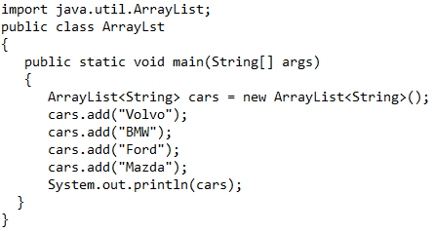
Methods of ArrayList
S
The ArrayList class has many useful methods. For example, to add elements to the ArrayList, use the add() method:
6

Slide 7
Methods of ArrayList (Cont…)
S
Output
[Volvo, BMW, Ford, Mazda]

Slide 8
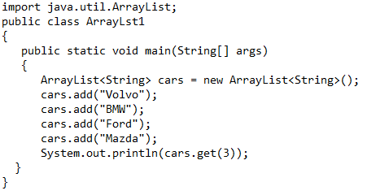
Methods of ArrayList (Cont…)
S
To access an element in the ArrayList, use the get() method and refer to the index number:
cars.get(3);
8

Slide 9
Methods of ArrayList (Cont…)
S
Output
Mazda

Slide 10
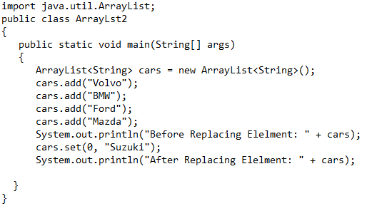
Methods of ArrayList (Cont…)
S
To modify an element, use the set() method and refer to the index number:
cars.set(0, “Suzuki");
10

Slide 11
Methods of ArrayList (Cont…)
S
Output
Before Replacing Elelment: [Volvo, BMW, Ford, Mazda]
After Replacing Elelment: [Suzuki, BMW, Ford, Mazda]

Slide 12
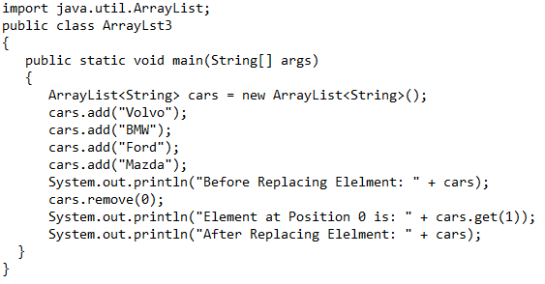
Methods of ArrayList (Cont…)
S
To remove an element, use the remove() method and refer to the index number:
cars.remove(0);
12

Slide 13
Methods of ArrayList (Cont…)
S
Output
Before Replacing Elelment: [Volvo, BMW, Ford, Mazda]
Element at Position 0 is: Ford
After Replacing Elelment: [BMW, Ford, Mazda]

Slide 14
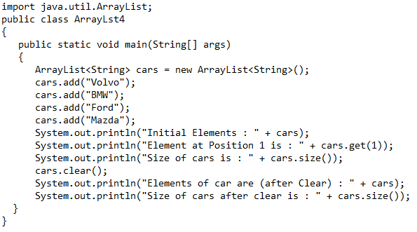
Methods of ArrayList (Cont…)
S
To remove all the elements in the ArrayList, use the clear() method:
cars.clear();
To find out how many elements an ArrayList have, use the size method:
cars.size();
14

Slide 15
Methods of ArrayList (Cont…)
S
Output
    Initial Elements : [Volvo, BMW, Ford, Mazda]
    Element at Position 1 is : BMW
    Size of cars is : 4
    Elements of car are (after Clear) : []
    Size of cars after clear is : 0

Slide 16
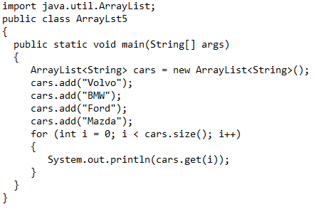
Loops in ArrayList
S
Loop through the elements of an ArrayList with a for loop, and use the size() method to specify how many times the loop should run.
16

Slide 17
Loops in ArrayList (Cont…)
S
Output
    Volvo
    BMW
    Ford
    Mazda

Slide 18
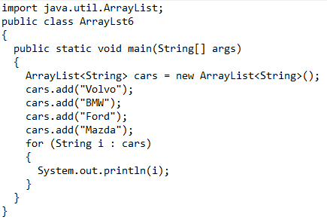
Loops in ArrayList (Cont…)
S

Slide 19
Loops in ArrayList (Cont…)
S
Output
    Volvo
    BMW
    Ford
    Mazda

Slide 20
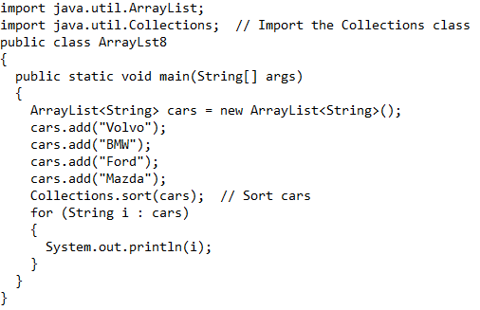
Loops in ArrayList
S
Another useful class in the java.util package is the Collections class, which include the sort() method for sorting lists alphabetically or numerically.
20

Slide 21
Loops in ArrayList (Cont…)
S
Output
    BMW
    Ford
    Mazda
    Volvo

Slide 22
Some Examples
S
Create an ArrayList to store numbers.

Slide 23
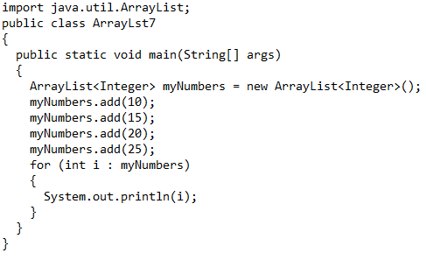
Some Examples (Cont…)
S

Slide 24
Some Examples (Cont…)
S
Output
    10
    15
    20
    25

Slide 25
Some Examples (Cont…)
S
Create an ArrayList of integers and sort the elements by using sort() method.

Slide 26
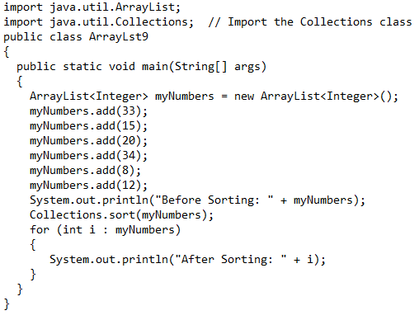
Some Examples (Cont…)
S

Slide 27
Some Examples (Cont…)
S
Output
    Before Sorting: [33, 15, 20, 34, 8, 12]
    After Sorting: 8
    After Sorting: 12
    After Sorting: 15
    After Sorting: 20
    After Sorting: 33
    After Sorting: 34

Slide 28




